Slide 1
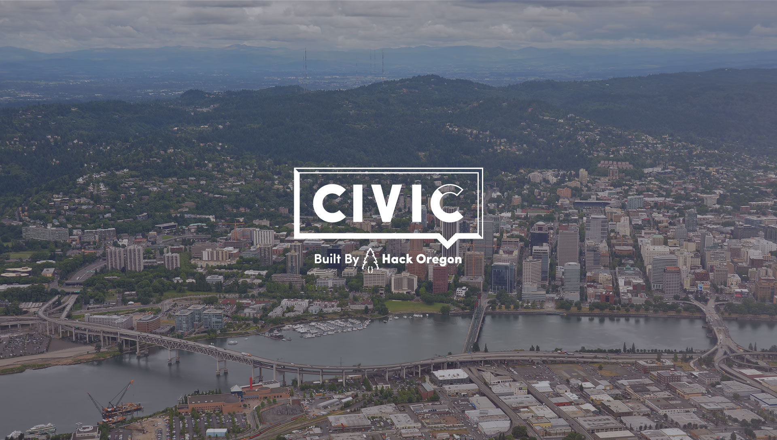
Ashland Daily Photo
http://traveljapanblog.com/ashland/2012/08/portland-oregon-from-the-air/

Slide 2
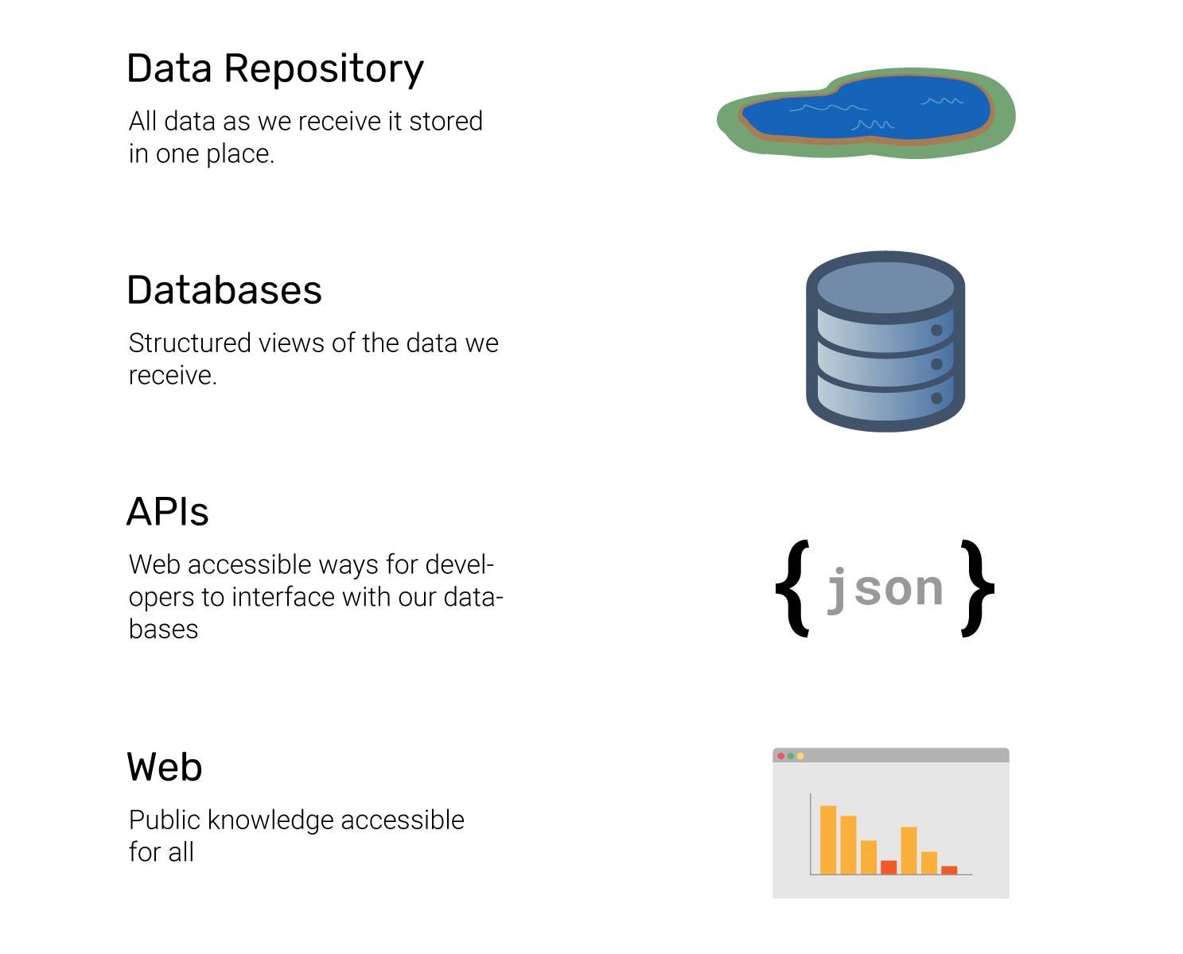

Slide 3
Learn Docker the Hack Oregon Way.

Slide 4
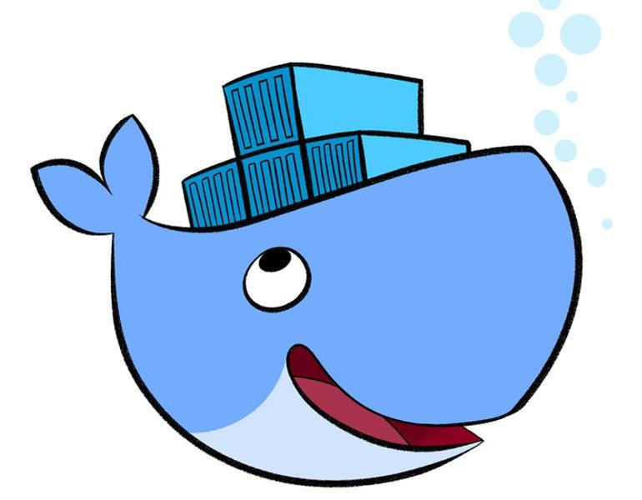

Slide 5
High-level takeaways
What it takes to run docker. (OS Wise)
Pulling and running a docker Image
Running a django docker project/hack oregon image
A basic understanding of docker security.
How we use docker in development.

Slide 6
TODO: Add this to slides.
Yaml talk
testing
Commit + travis deploy

Slide 7
Docker Vocab
Image
  A package with all the dependencies and information needed to create a container. An image includes all the dependencies (such as frameworks) plus deployment and execution configuration to be used by a container runtime.
Container
  An instance of a Docker image. A container represents the execution of a single application, process, or service.
Volumes
  Offer a writable filesystem that the container can use. Since images are read-only but most programs need to write to the filesystem, volumes add a writable layer, on top of the container image, so the programs have access to a writable filesystem.
Dockerfile
  A text file that contains instructions for how to build a Docker image. It's like a batch script, the first line states the base image to begin with and then follow the instructions to install required programs, copy files and so on, until you get the working environment you need.

Slide 8
OS requirements
If you’re running windows, you’re gonna have a bad time.
Linux and mac make docker :)

Slide 9
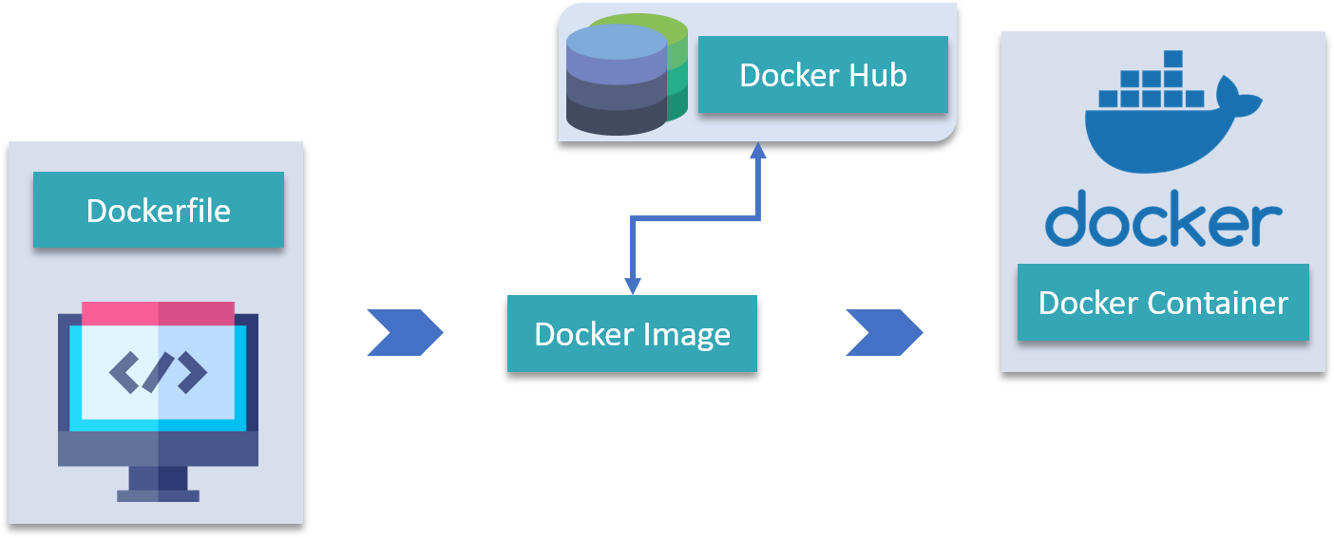
Docker Basics - What is it?
Notes:
Can create a docker image both from a local docker file and from docker hub

Slide 10
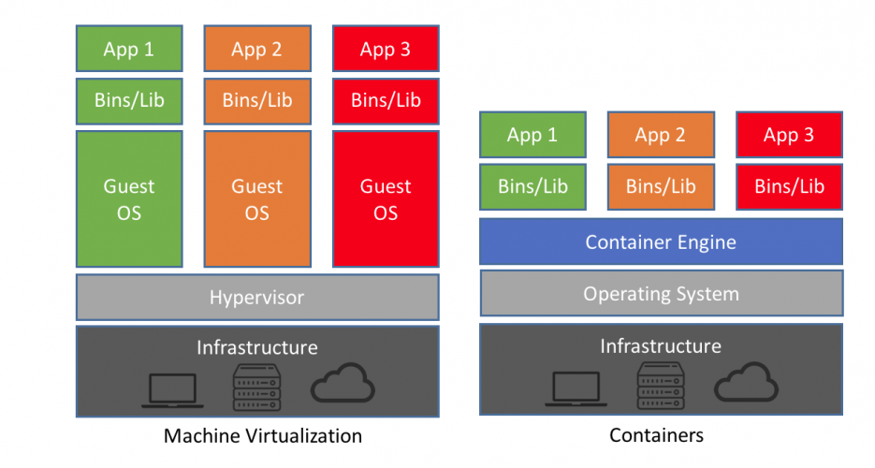
Container vs VM
Notes:
Large part of making “cloud” and “serverless” computing possible, isolate code, and reduce cpu load/memory/other resources

Slide 11
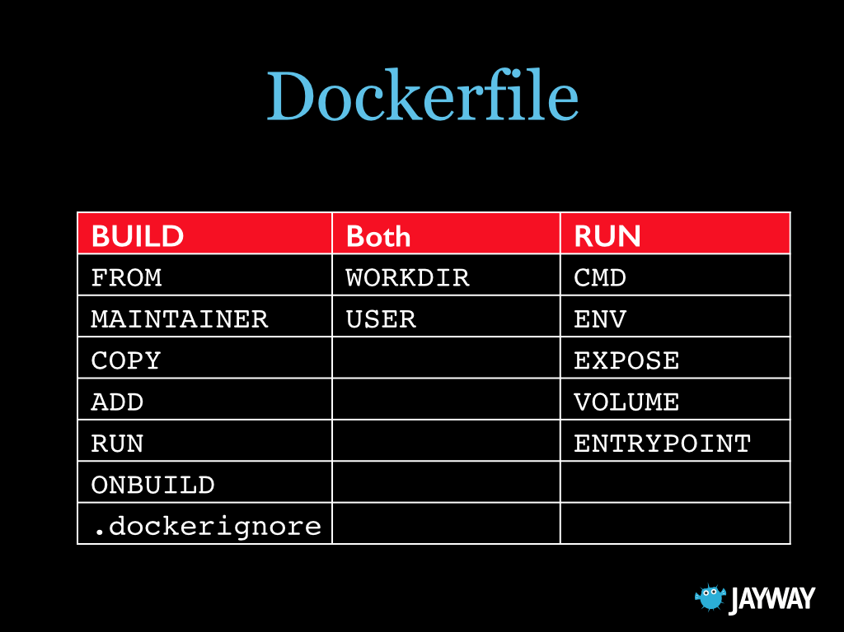
Dockerfile Basics
Notes:
Important concepts in dockerfile

Slide 12
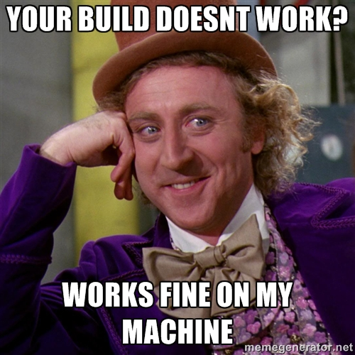
Docker Basics - How we use it.
Notes:
Provide an environment for development and accessing data locally
Helps in configuring and managing production…
“It works on my machine” is less of an issue

Slide 13
Demo - Install Docker
  https://docs.docker.com/get-started/
For me I had to run
  sudo apt-get install -y docker-ce
Let's confirm the Install.
  Run docker --version
  You should see something like:
    Docker version 18.09.6, build 481bc77

Slide 14
Docker - Test the Install.
## List Docker CLI commands
docker
docker container --help
## Display Docker version and info
docker --version
docker version
docker info
## Execute Docker image
docker run hello-world
## List Docker images
docker image ls
## List Docker containers (running, all, all in ##quiet mode)
docker container ls
docker container ls --all
docker container ls -aq
docker run hello-world
  You don’t have it locally, so it will pull the image.
  Look it worked
Run: docker image ls
  This shows you all docker images on your machine

Slide 15
Pulling and running a Image from dockerhub
If you have a dockerhub account, change your passwords. They had a breach.
https://hub.docker.com/r/06kellyjac/nyancat/
  To run Nyan cat:
  docker run -it --rm --name nyancat 06kellyjac/nyancat
  This will pull and run it.
Notes:
Docker Repository -dockerhub
How to pull and build image locally
How to run docker image
Both through docker cli
Docker-compose

Slide 16
Demo - pull and run the datascience container.
Put instructions on slide. Run basic docker
https://github.com/karenng-civicsoftware/HackORDataScienceTemplate
https://cloud.docker.com/repository/docker/karenngcivicsoftware/hackordatasciencetemplate

Slide 17
Demo - pull and run the backend container.
Put instructions on slide. Run basic docker
https://github.com/hackoregon/2019-backend-docker/tree/staging
https://hub.docker.com/r/hackoregoncivic/backend-docker-django-dev

Slide 18
Running a django docker project
  Break down parts of the image
  File system mounting
  Port mapping
  Environmental variables/credentials
Show how to build locally and change things a bit/

Slide 19
Docker Security
We just try and follow best practices
https://docs.docker.com/develop/develop-images/dockerfile_best-practices/
Don’t bake in the passwords

Slide 20
Changes from last year.
In the past we haven’t deployed images to docker hub,we would build from base python images.
This year we have the image repo.
The idea this year is we makes changes, trigger build, update all the projects. Abstracting the infrastructure.

Slide 21
Docker development
  How to create images/files
  Best practices for organization
  Pushing to repository -docker push
End with deployment to ecs

Slide 22
Docker Further Resources
Docker docs:
https://docs.docker.com/
Quick overview of some best practices:
https://docs.docker.com/develop/dev-best-practices/
The base pattern we build from:
https://docs.docker.com/compose/django/
Exploration of the ways variables can be set in a docker container:
https://vsupalov.com/docker-arg-env-variable-guide/

Slide 23
Thank you!
Nick A. | Karen N.
Stephen T.L. | Brian G.
Mary Anne T.

